Slide 1
Chapter 4
Applications of Derivatives
Copyright © 2010 Pearson Education, Inc. Publishing as Pearson Addison-Wesley

Slide 2
4.1
Extreme Values of Functions
Copyright © 2010 Pearson Education, Inc. Publishing as Pearson Addison-Wesley

Slide 3
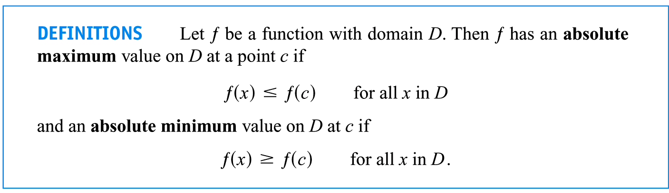

Slide 4
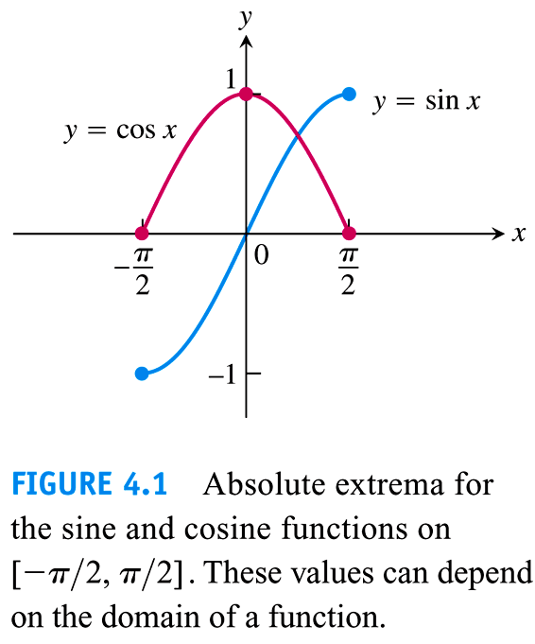

Slide 5
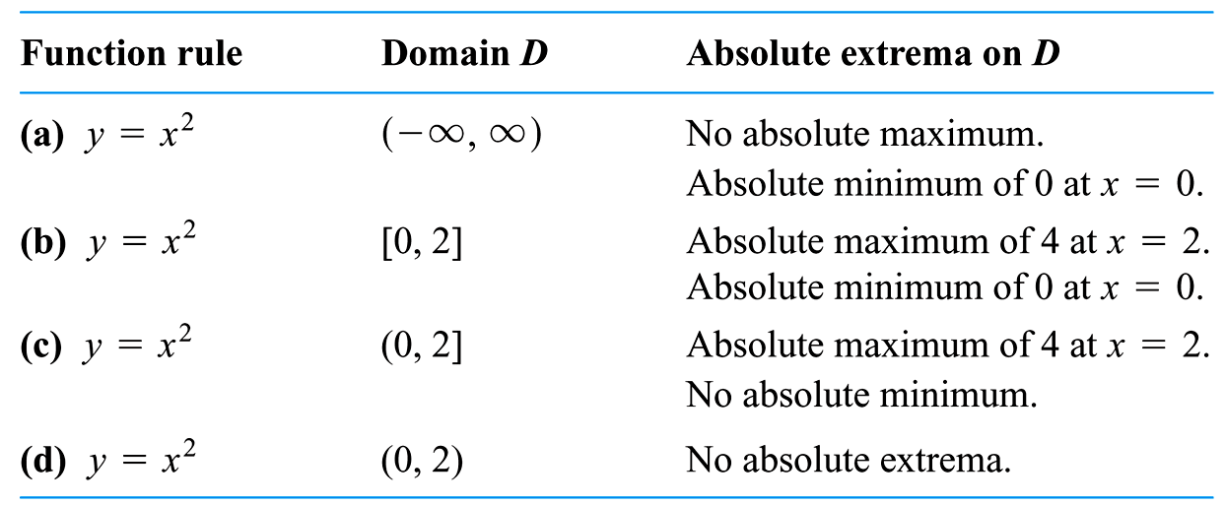

Slide 6
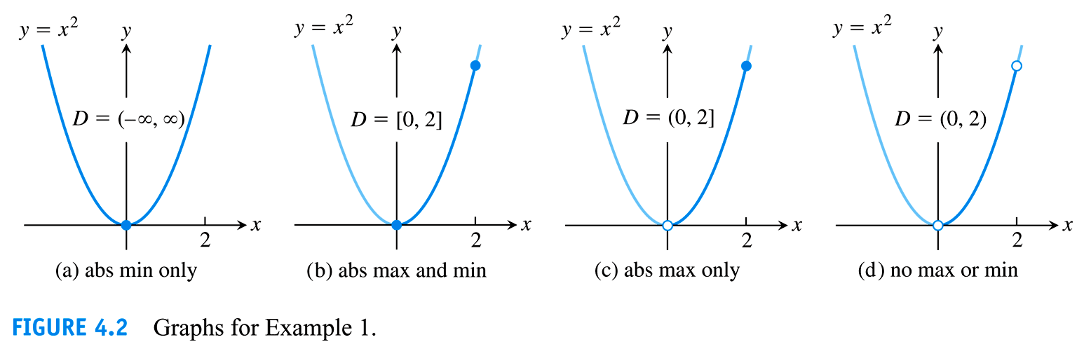

Slide 7
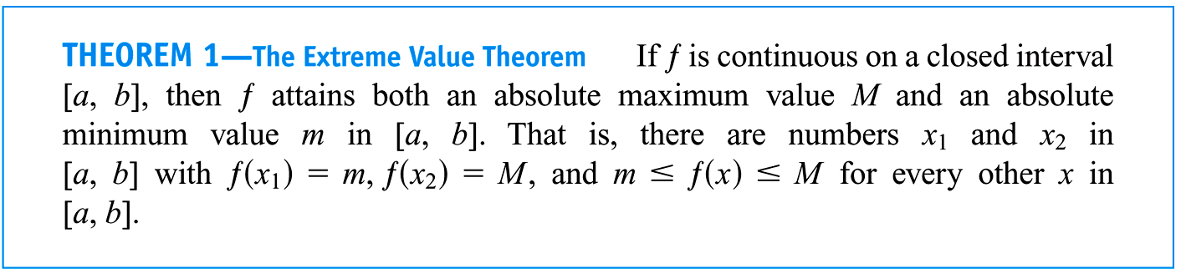

Slide 8
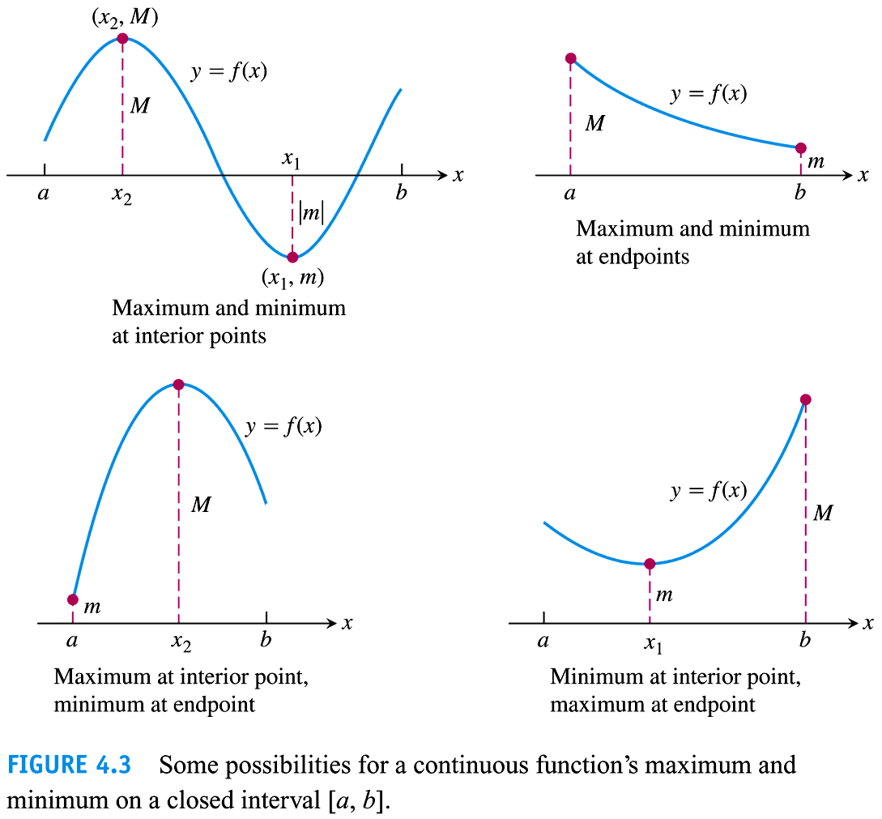

Slide 9
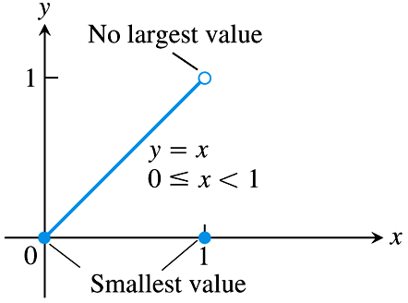
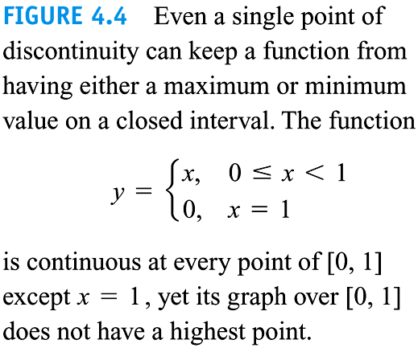

Slide 10
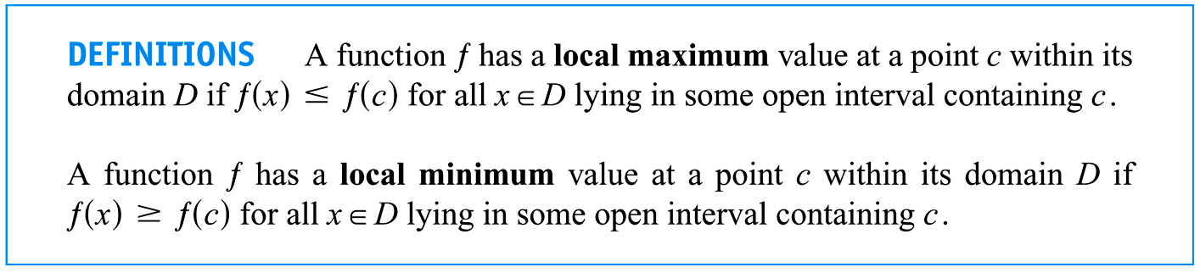

Slide 11
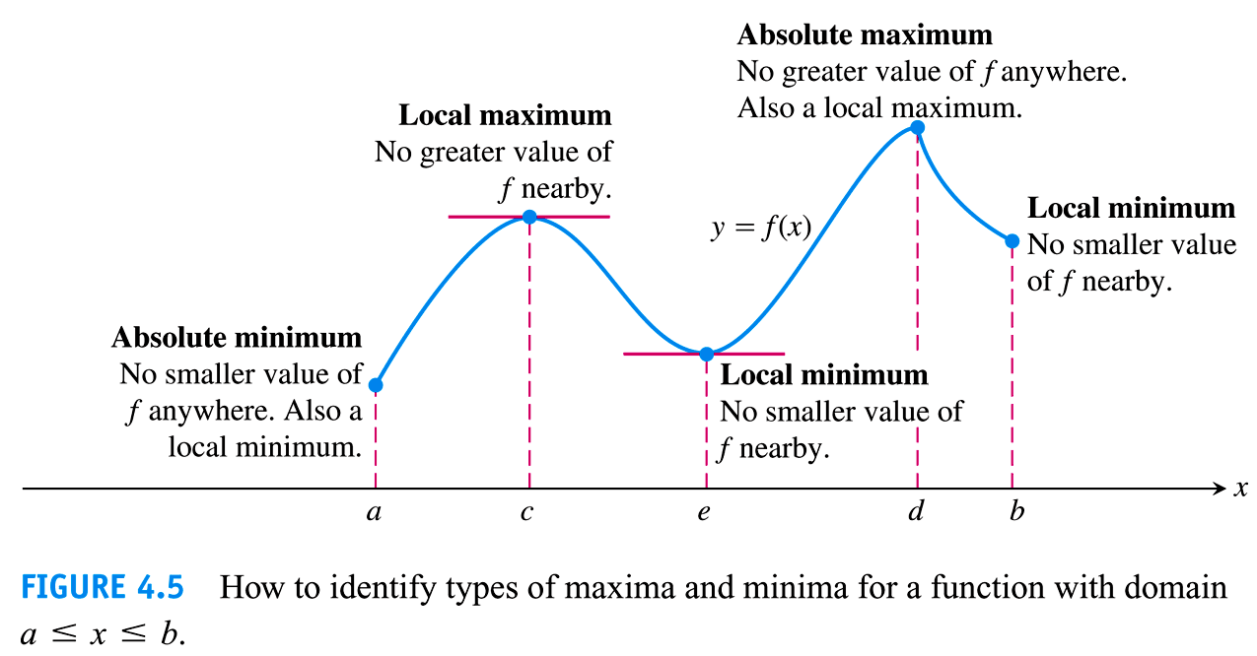

Slide 12
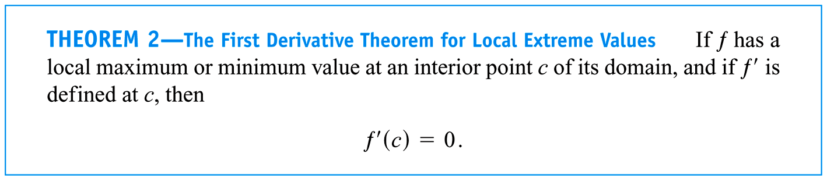

Slide 13
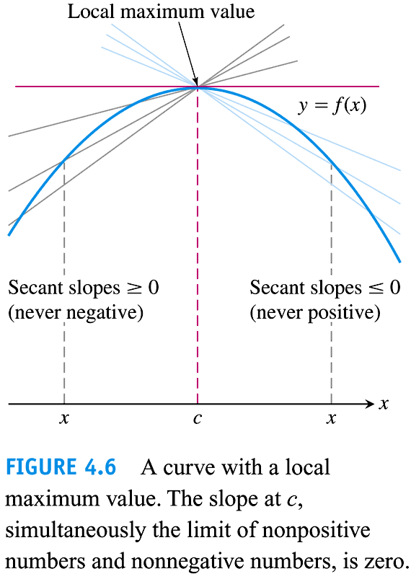

Slide 14
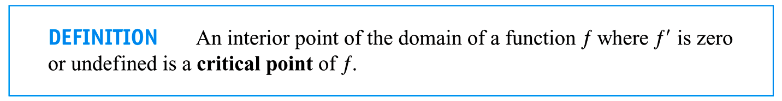

Slide 15
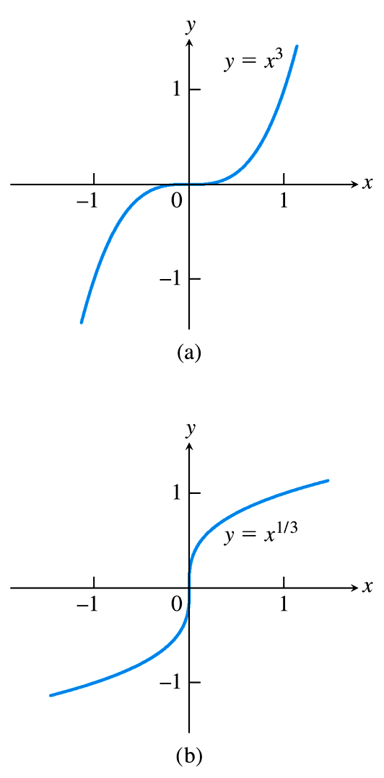
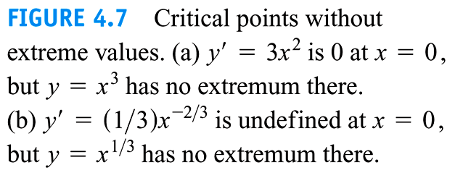

Slide 16
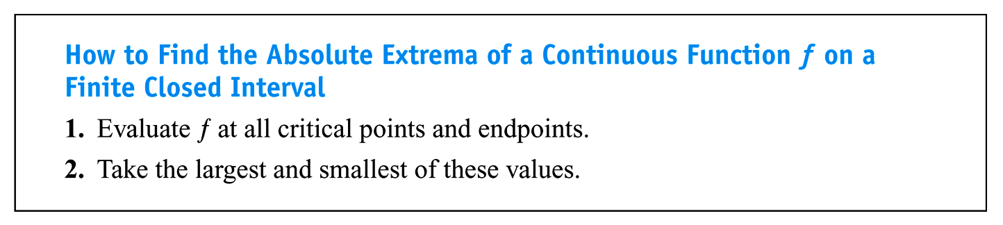

Slide 17
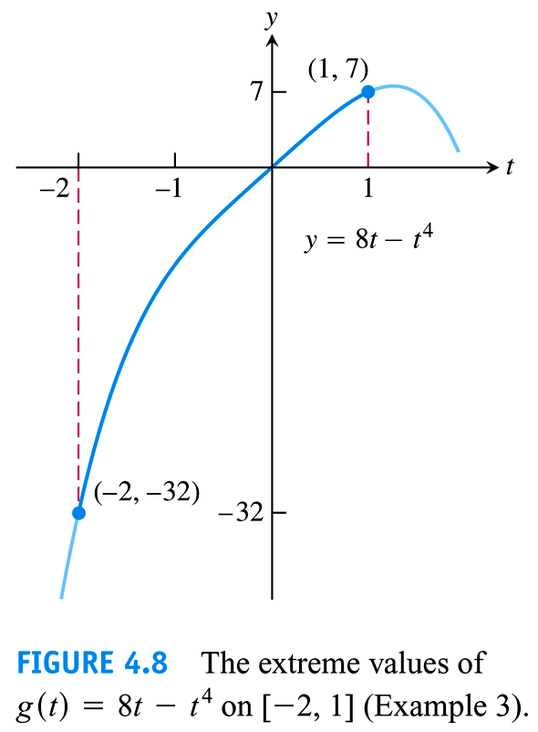

Slide 18
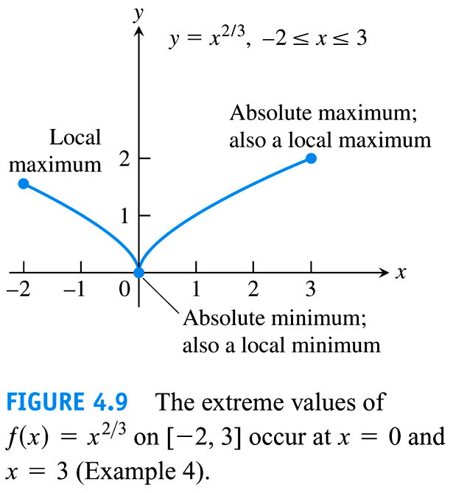

Slide 19
4.2
The Mean Value Theorem
Copyright © 2010 Pearson Education, Inc. Publishing as Pearson Addison-Wesley

Slide 20
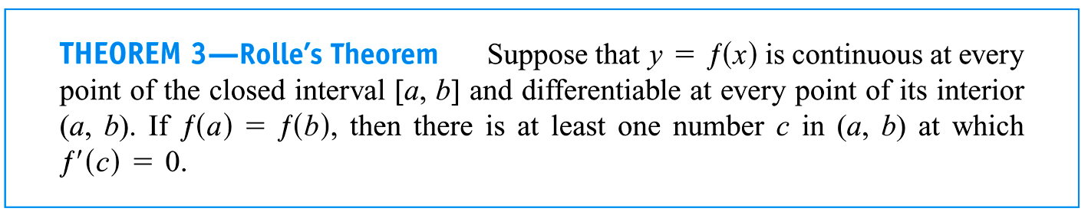

Slide 21
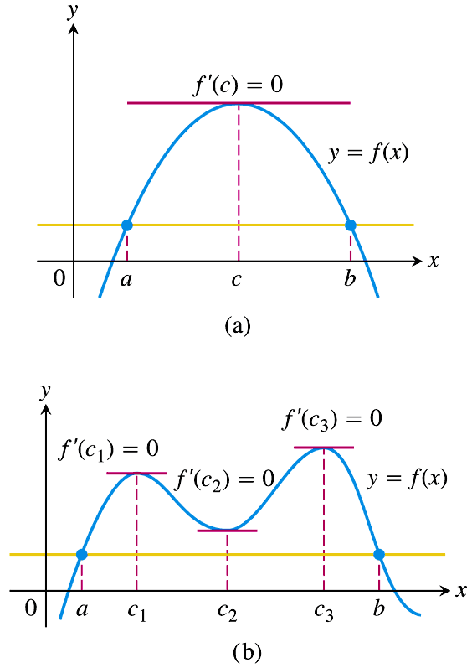
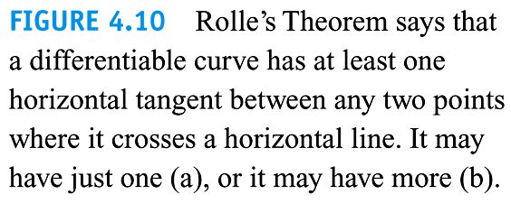

Slide 22
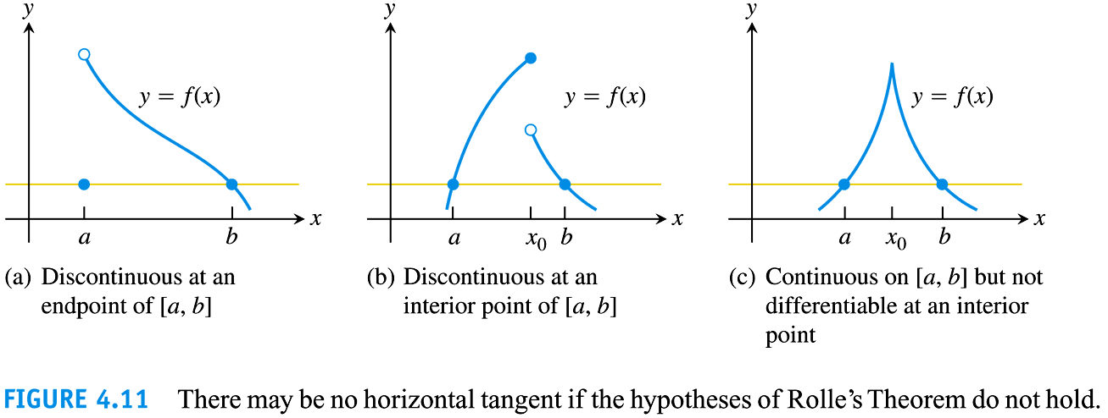

Slide 23
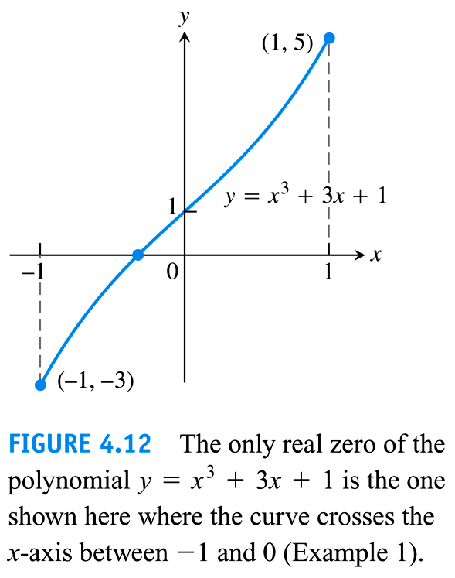

Slide 24
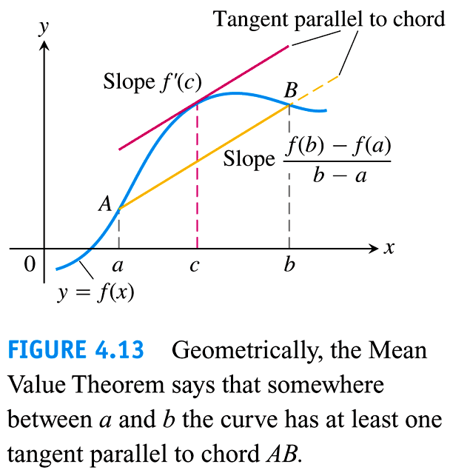

Slide 25
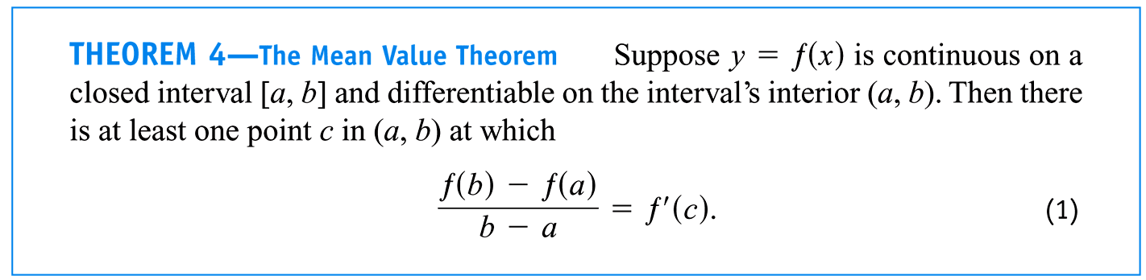

Slide 26
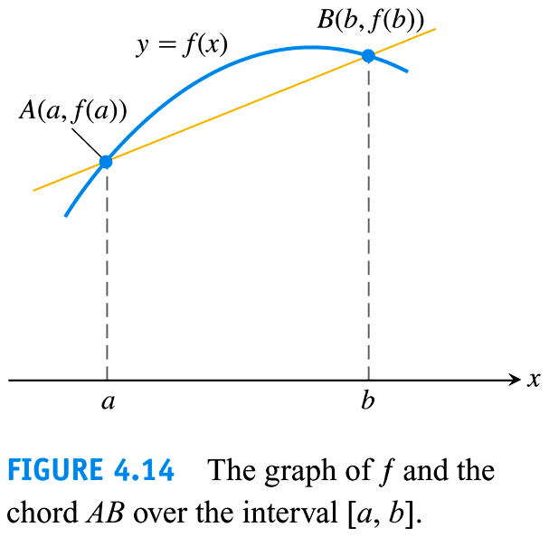

Slide 27
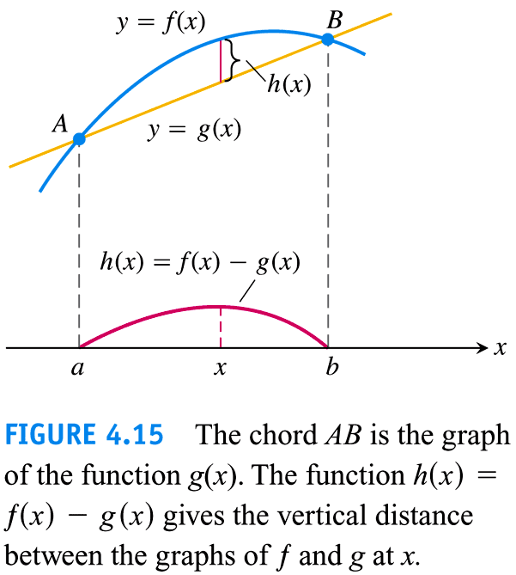

Slide 28
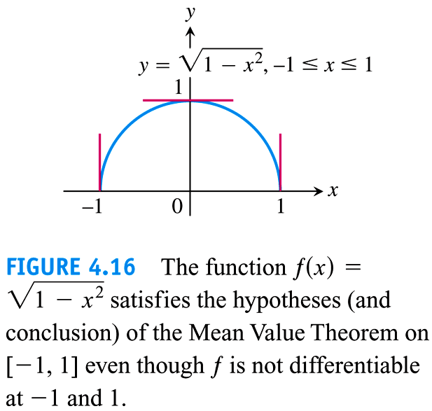

Slide 29
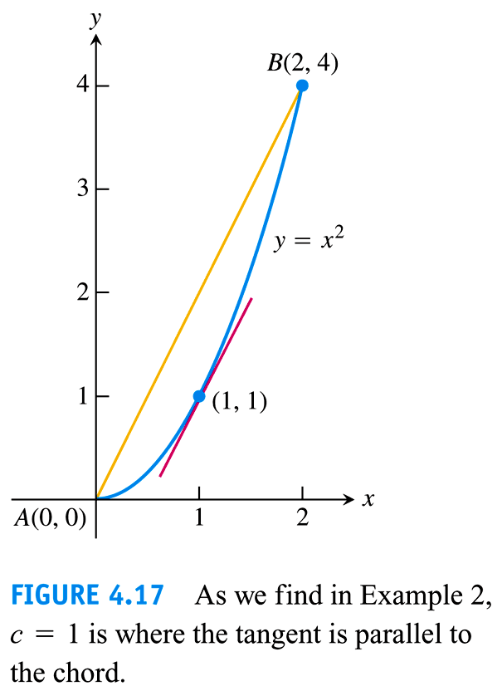

Slide 30
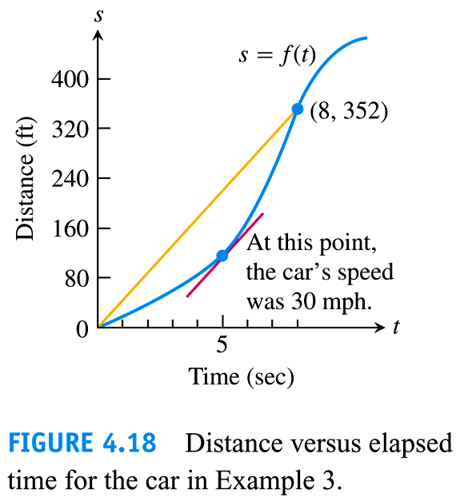

Slide 31
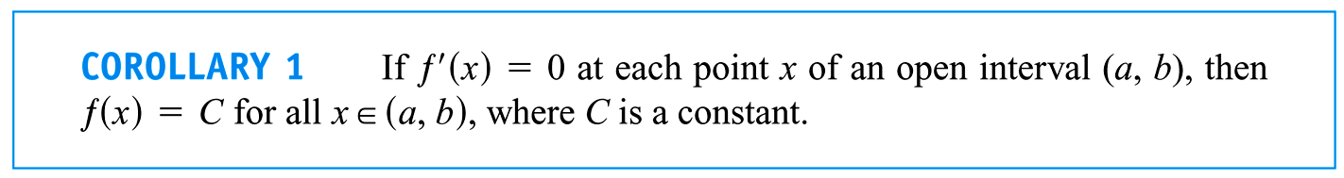
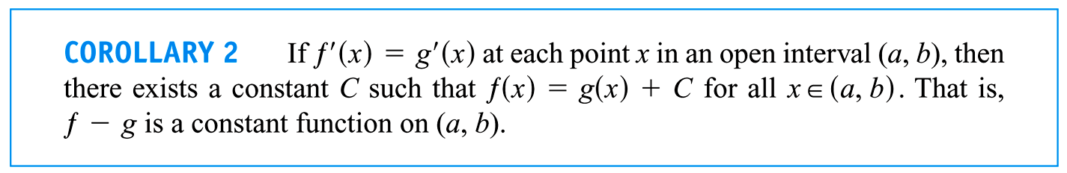

Slide 32
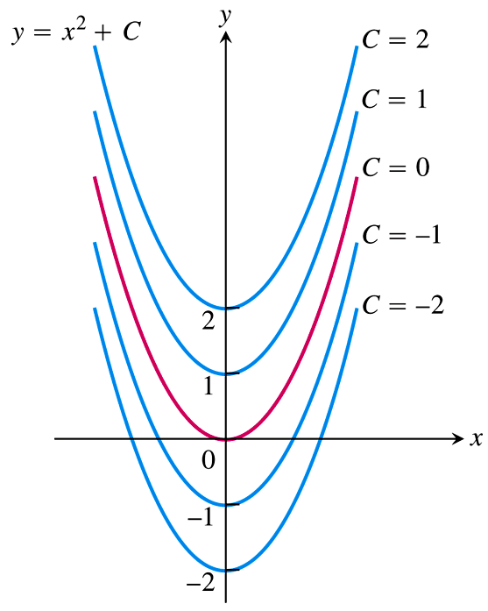
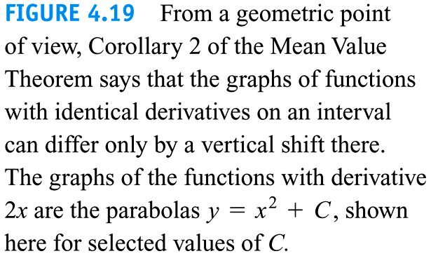

Slide 33
4.3
Monotonic Functions and the First Derivative Test
Copyright © 2010 Pearson Education, Inc. Publishing as Pearson Addison-Wesley

Slide 34
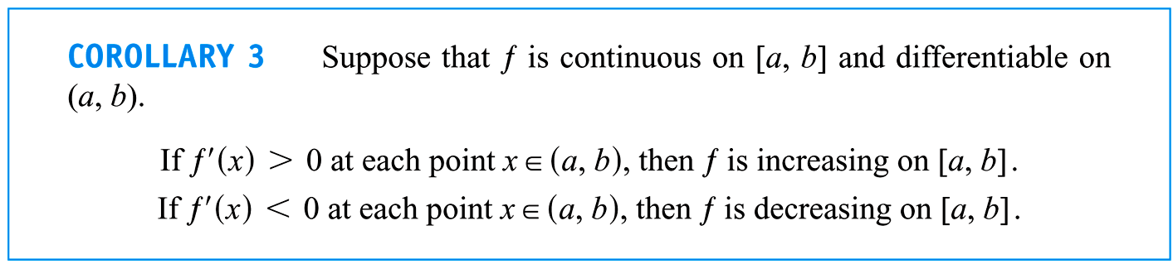

Slide 35
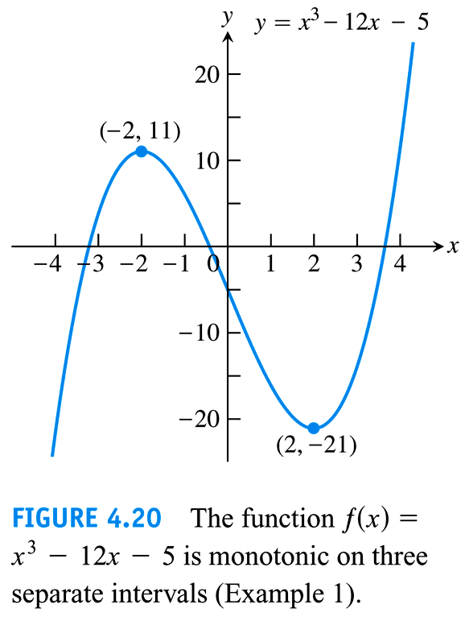

Slide 36
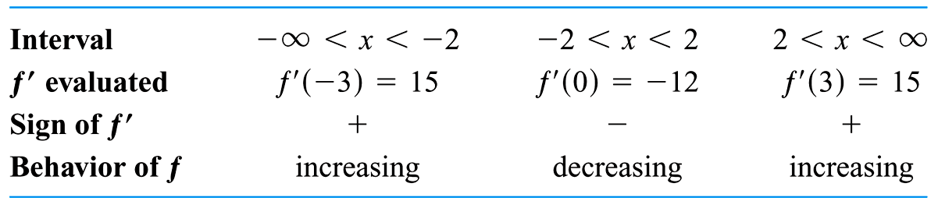

Slide 37
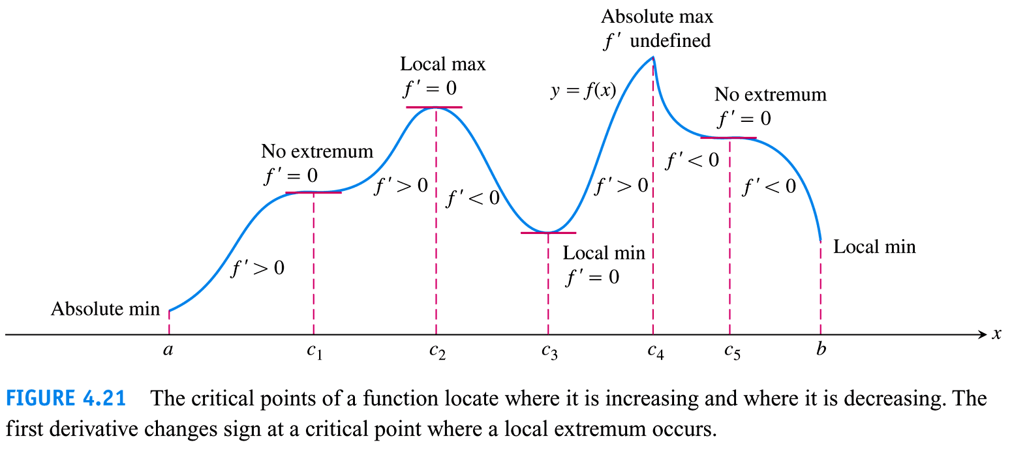

Slide 38
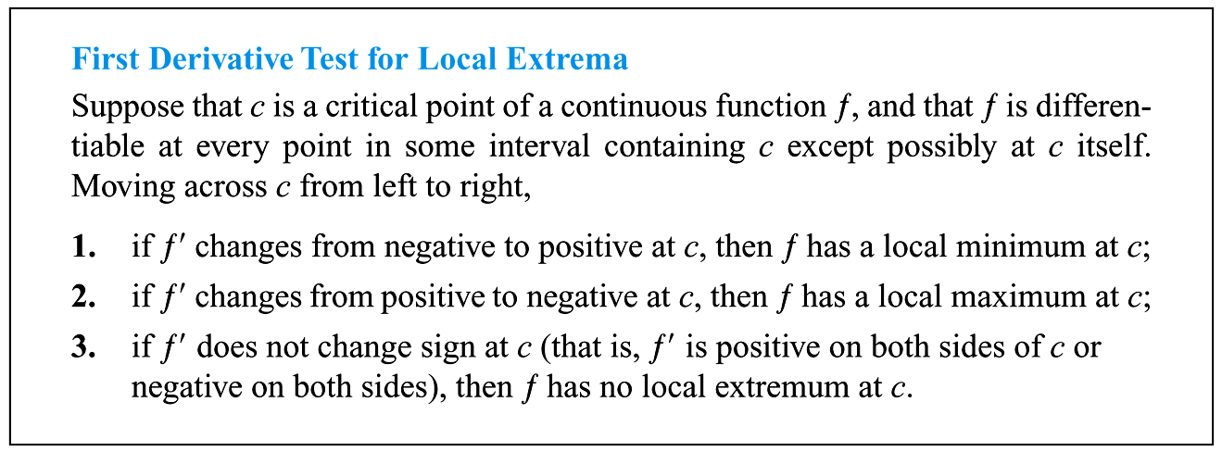

Slide 39
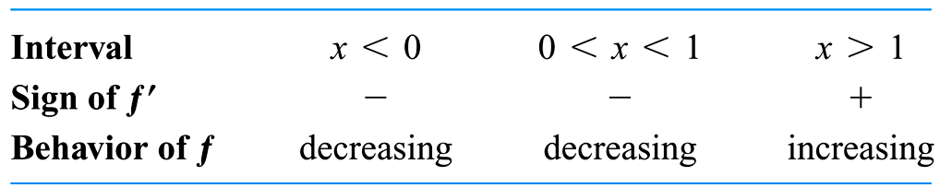

Slide 40
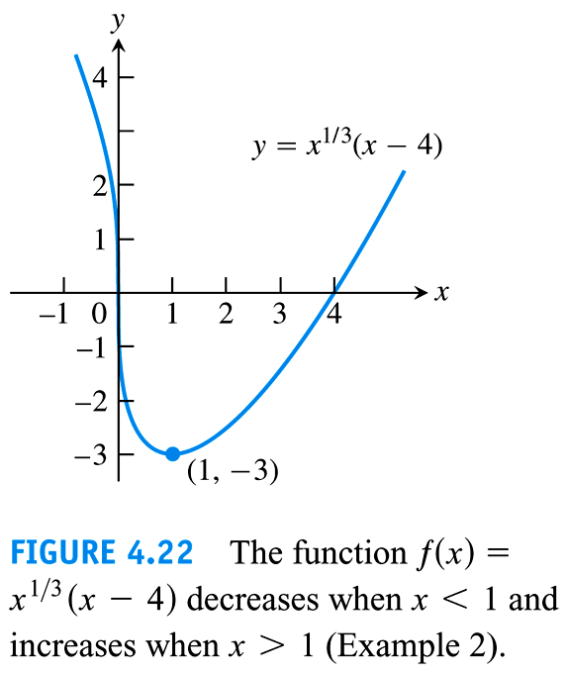

Slide 41
4.4
Concavity and Curve Sketching
Copyright © 2010 Pearson Education, Inc. Publishing as Pearson Addison-Wesley

Slide 42
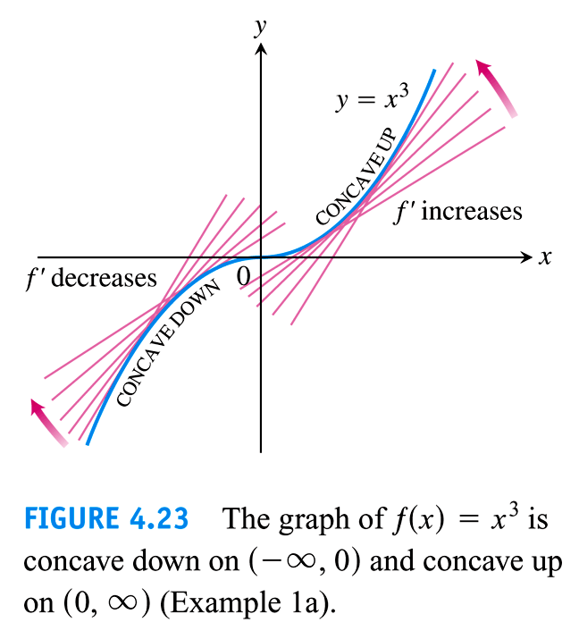

Slide 43
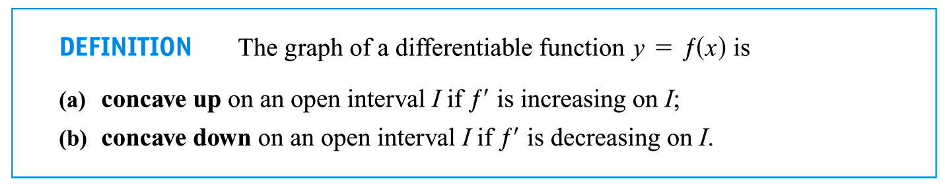

Slide 44
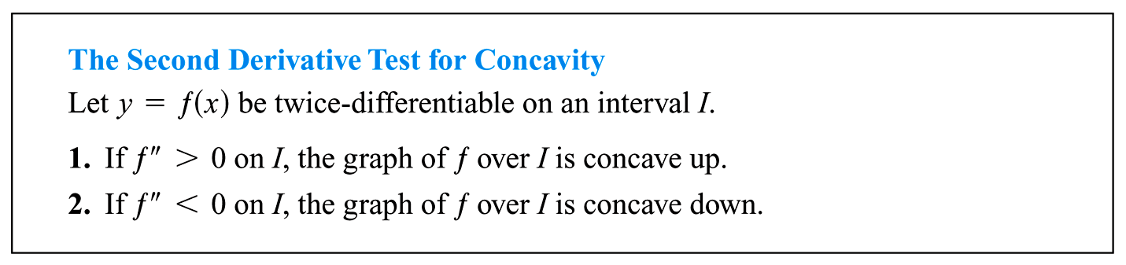

Slide 45
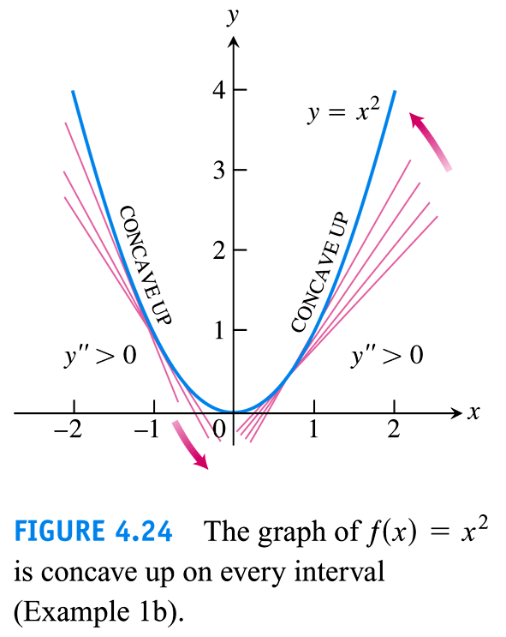

Slide 46


Slide 47
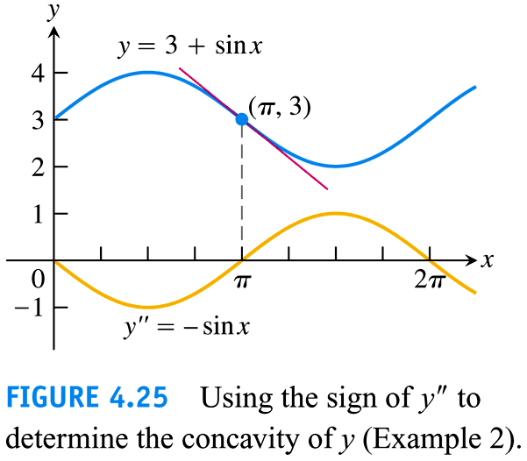

Slide 48
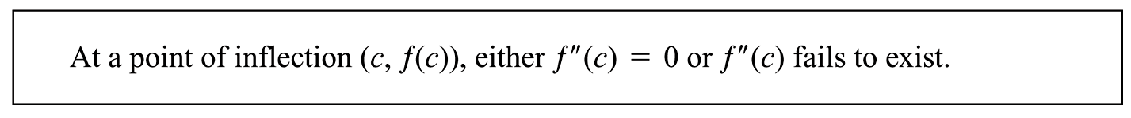

Slide 49
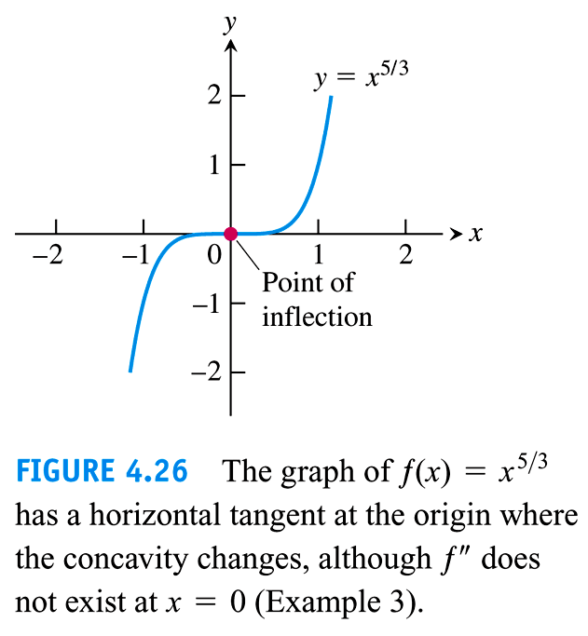

Slide 50
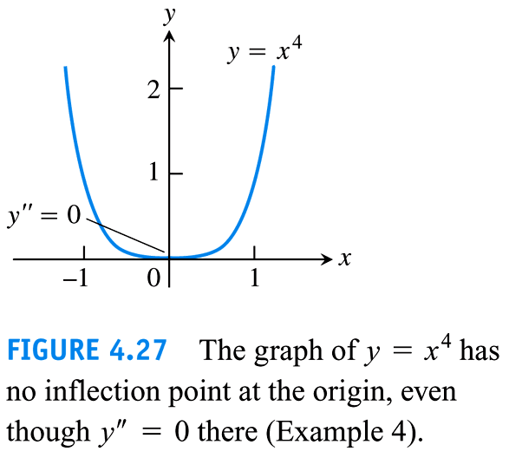

Slide 51
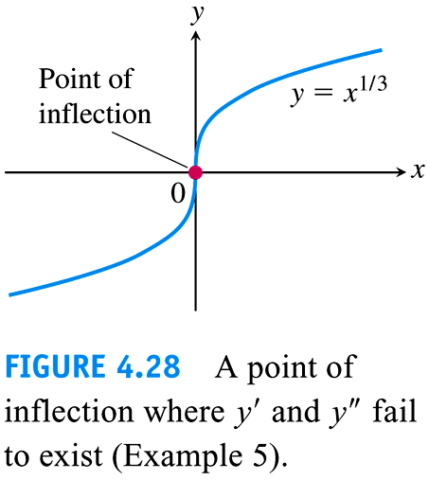

Slide 52



Slide 53


Slide 54


Slide 55




Slide 56


Slide 57


Slide 58


Slide 59


Slide 60


Slide 61
4.5
Applied Optimization
Copyright © 2010 Pearson Education, Inc. Publishing as Pearson Addison-Wesley

Slide 62



Slide 63


Slide 64


Slide 65


Slide 66


Slide 67


Slide 68


Slide 69


Slide 70


Slide 71


Slide 72


Slide 73
4.6
Newton’s Method
Copyright © 2010 Pearson Education, Inc. Publishing as Pearson Addison-Wesley

Slide 74


Slide 75


Slide 76


Slide 77


Slide 78


Slide 79


Slide 80


Slide 81


Slide 82


Slide 83


Slide 84
4.8
Antiderivatives
Copyright © 2010 Pearson Education, Inc. Publishing as Pearson Addison-Wesley

Slide 85


Slide 86


Slide 87


Slide 88


Slide 89


Slide 90


Slide 91


